Slide 1
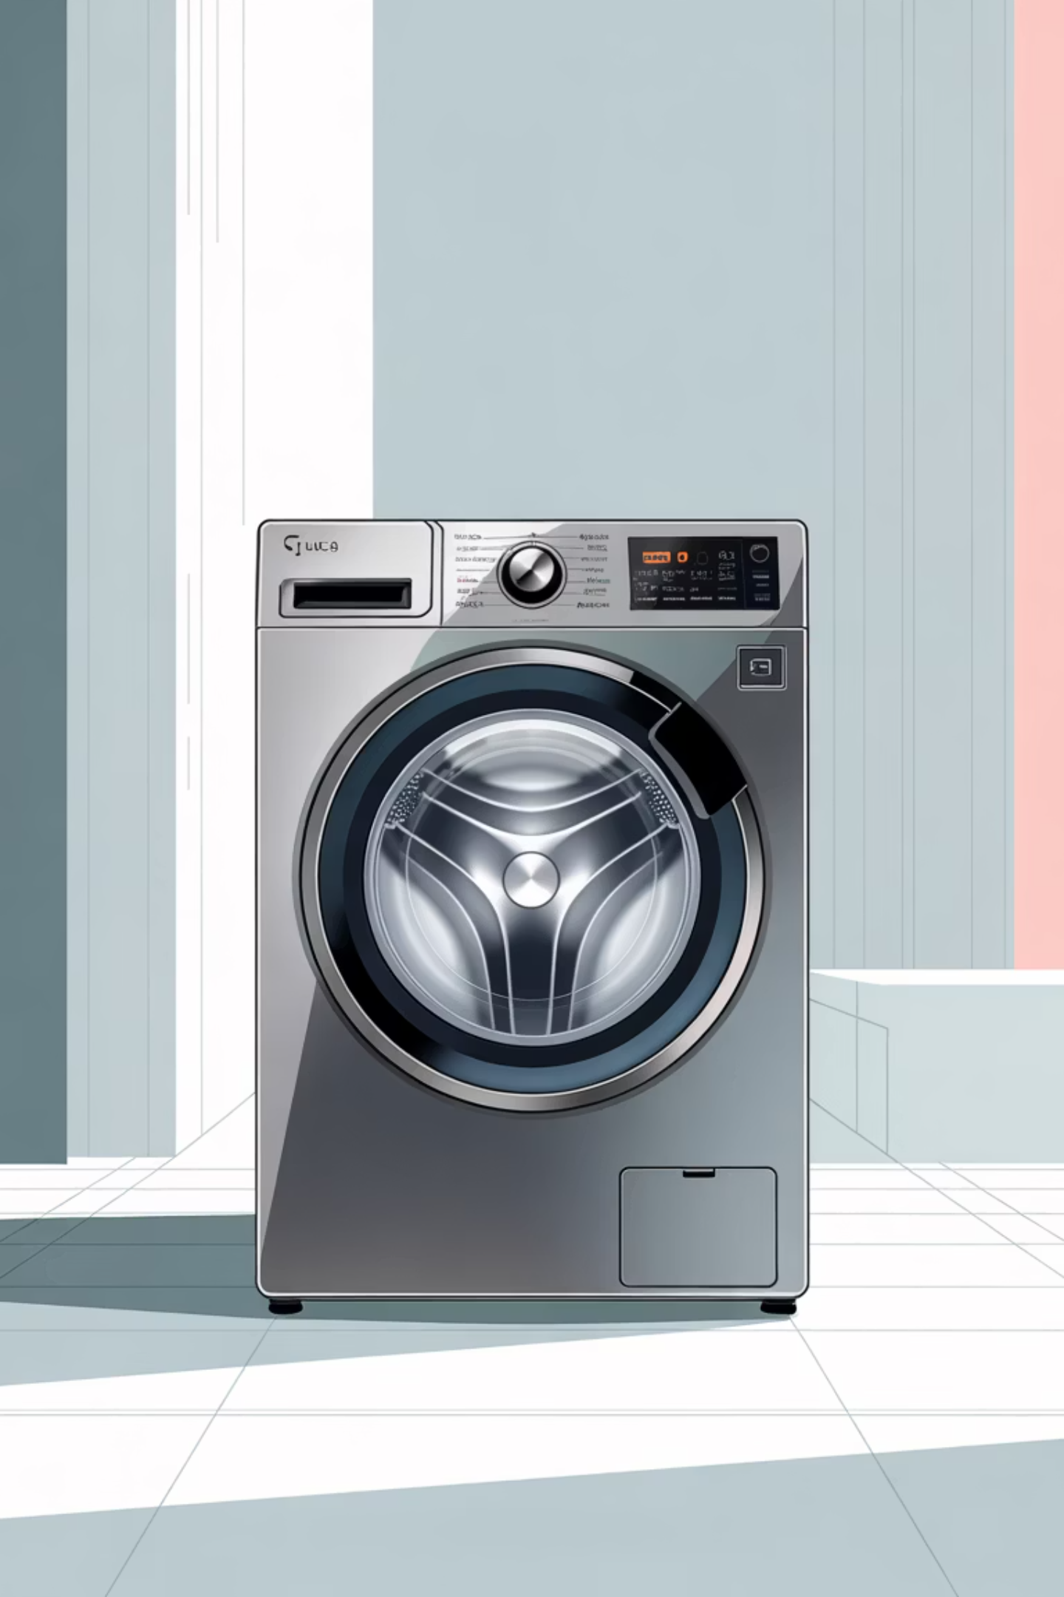
Automatic Washing Machine
FPGA-Based Control System Design
REDDY SOMA SAI SATYA SNIGDHA (BU21EECE0100200)
MONISHA H S (BU22EECE0100439)
DHEERAJ LAKSHMAN (BU21EECE0100305)
ALLI GOPI (BU21EECE0100161)
DARSHAN P (2023007316)

Slide 2

Introduction to Automatic Washing Machines
Automatic washing machines have revolutionized household chores by automating the entire washing process—from soaking and washing to rinsing and spinning—without constant human intervention. These appliances save time, reduce physical effort, and ensure consistent performance.
Modern machines incorporate programmable settings, multiple wash cycles, and intelligent sensors that adapt to different fabric types, load sizes, and soil levels. Smart technology enables remote control and monitoring, adding unprecedented convenience to daily laundry routines.
This project explores the key components, design principles, and technological advancements that make automatic washing machines essential modern appliances, examining their development and impact on household efficiency.

Slide 3
Overview: How Automatic Washing Machines Work
01
02
03
Water Filling
Detergent Dispensing
Agitation & Washing
The machine automatically fills the tub with the precise amount of water needed for the load size and cycle selected.
Detergent is automatically added at the optimal time during the wash cycle for maximum cleaning effectiveness.
The motor drives the drum or agitator to thoroughly clean clothes through mechanical action and chemical interaction.
04
05
Rinsing
Spinning & Drying
Multiple rinse cycles remove detergent residue, ensuring clean and fresh-smelling garments.
High-speed spinning removes excess water, significantly reducing drying time and energy consumption.

Slide 4

Methodology: Software & Hardware Components
Software: Xilinx Vivado
Hardware: FPGA Boards
An advanced FPGA design suite supporting Verilog, VHDL, and high-level synthesis. Vivado enables design entry, simulation, debugging, and bitstream programming—essential for designing the washing machine's control logic and validating functionality before hardware deployment.
The Nexys 4 DDR Artix-7 FPGA board features a high-capacity FPGA, generous external memory, USB/Ethernet ports, and built-in peripherals including accelerometers and temperature sensors—ideal for hosting complex control systems without additional components.

Slide 5
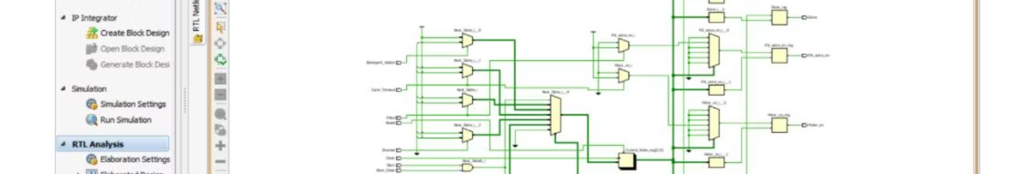
Block Diagram: System Architecture
The block diagram illustrates the complete system architecture, showing how the FPGA control unit manages all washing machine operations. Input sensors (door close, water level, detergent status, cycle timeout, spin timeout) feed data to the controller, which outputs control signals to actuators (motor, fill valve, drain valve, door lock). This hierarchical design ensures synchronized operation of all components throughout the washing cycle.

Slide 6
Control Logic Implementation
The washing machine control system uses a finite state machine (FSM) with six distinct states: Check Door, Fill Water, Add Detergent, Cycle, Drain Water, and Spin. Each state manages specific operations and transitions based on sensor inputs.
Check Door
Fill Water
Verifies door closure and start signal before proceeding
Opens fill valve until water level sensor confirms full tank
Add Detergent
Cycle
Dispenses detergent when signal received
Activates motor for washing duration
Drain Water
Spin
Opens drain valve until empty
Spins drum to remove excess water

Slide 7
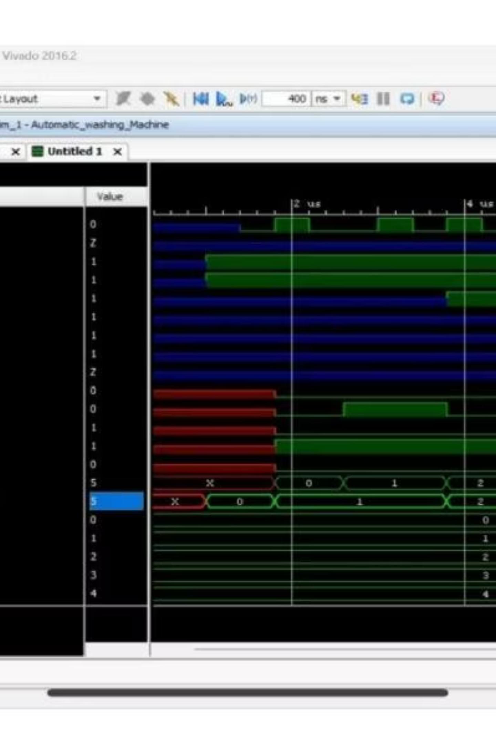
RTL Design & Simulation Results
The RTL (Register Transfer Level) design translates the high-level washing algorithm into detailed hardware descriptions using Verilog. This critical stage creates modules for water level control, motor management, cycle timing, and sensor interfacing, ensuring efficient synchronization of all operations.
Extensive simulations using Xilinx Vivado validated the RTL design under various real-world scenarios. The simulation environment tested filling, washing, rinsing, and spinning operations under different conditions. Results confirmed correct control logic operation, appropriate sensor response, and proper cycle management. Key performance metrics including cycle time, water usage, and energy efficiency were verified to meet design specifications.

Slide 8
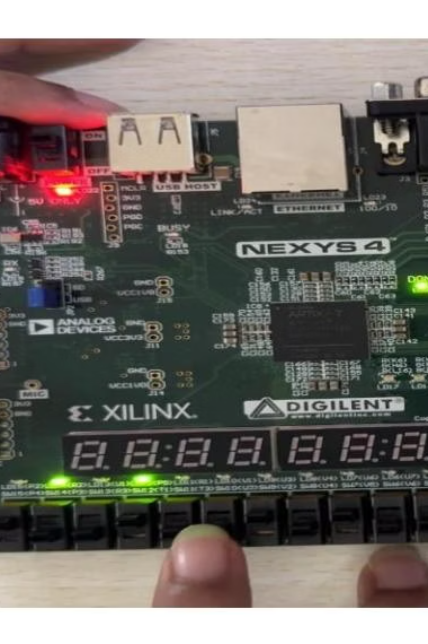
FPGA Implementation & Hardware Testing
The verified RTL design was synthesized into a bitstream and implemented on the Digilent Nexys 4 DDR Artix-7 FPGA board. This real hardware environment enables comprehensive testing of the washing machine control system with actual sensor inputs and actuator outputs.
The Nexys 4's rich I/O peripherals and built-in features facilitate thorough validation of system performance. The FPGA's flexibility allows for design adjustments and optimizations based on hardware test results, ensuring the final implementation is robust, reliable, and ready for practical deployment in household appliances.

Slide 9
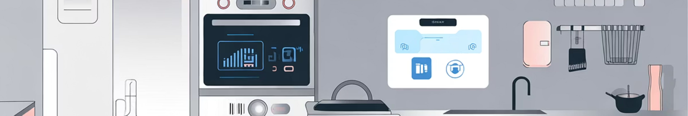
Key Achievements & Future Directions
Successful Design
Validated Performance
Future Optimization
Demonstrated feasibility of FPGA technology for complex household appliance control systems with reliable operation across all washing cycles.
RTL simulation and hardware testing confirmed correct functionality, sensor responsiveness, and efficient cycle management under diverse operating conditions.
Planned enhancements include power consumption optimization, remote control capabilities, and machine learning-based cycle optimization for improved efficiency and user experience.

Slide 10
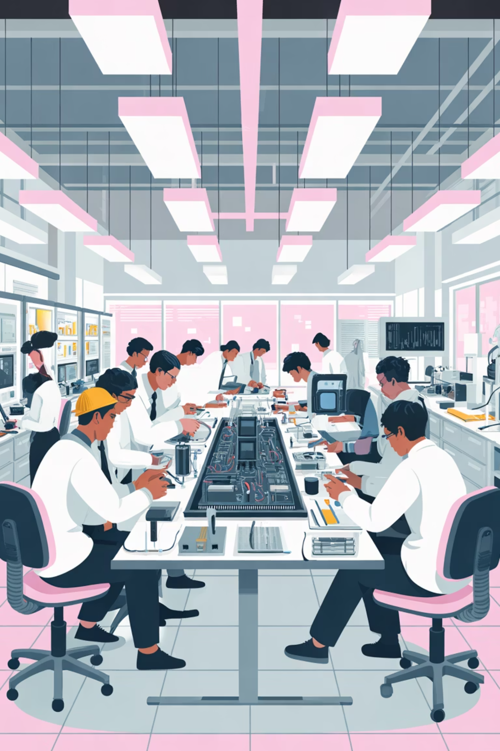

Conclusion & Resources
This project successfully demonstrates the design, simulation, and implementation of an FPGA-based automatic washing machine control system. The work highlights the critical importance of RTL design methodology and comprehensive simulation in developing reliable, efficient control systems for modern household appliances.
The integration of digital electronics, FPGA technology, and intelligent sensor systems showcases how advanced engineering principles transform everyday appliances into sophisticated, user-friendly devices that enhance quality of life.
Project Resources: Complete video tutorials and Xilinx Vivado setup guides available at the project repository. Reference materials include Digilent FPGA documentation and Xilinx design tools documentation for further learning and implementation.

